Slide 1


Time Series Forecasting (w. Machine Learning)
Filotas Theodosiou: VIVES University of Applied Sciences, Kortrijk, Belgium
Notes:
Introduction:
Mix of Practical and theoretical stuff with more practical I would say.
I will introduce time series, forecasting and build step by step. The goal is to understand what is a time series, what is forecasting, how to apply ml for forecasting and in general how to approach forecasting applications.
In the beginning you will be a bit patient because we need some theoretical material to understand the basics. Then we will have more practical stuff so it will not be as boring.
We will do some breaks when it starts getting boring.

Slide 2

About:
My name is Filotas Theodosiou
Senior Data Scientist – AI Researcher
Expertise in Forecasting
Member of the International Institute of Forecasters
Member of the Belgium Forecasting Centers
Teaching Machine Learning Operations (MLOps)
Link (with extra links): https://filtheo.github.io/

Slide 3
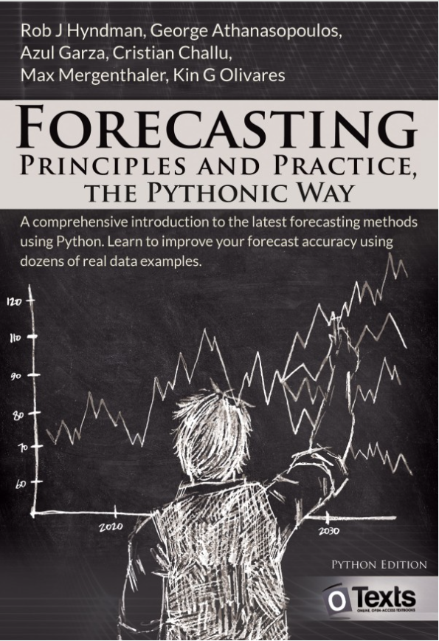
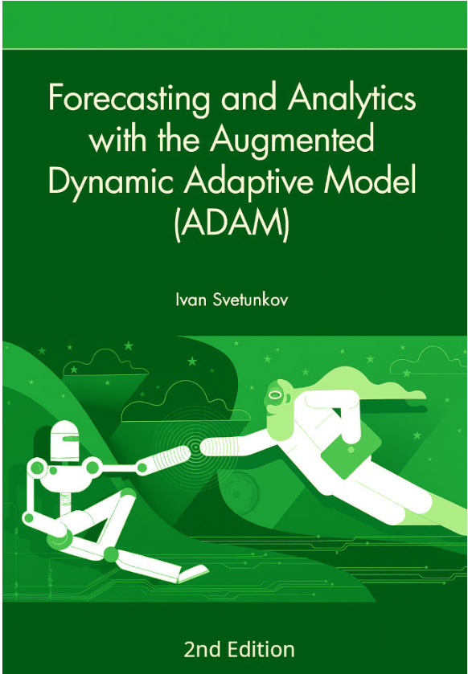
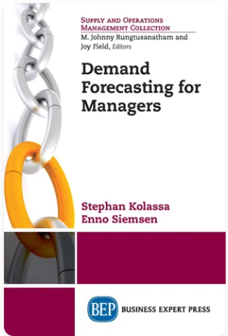
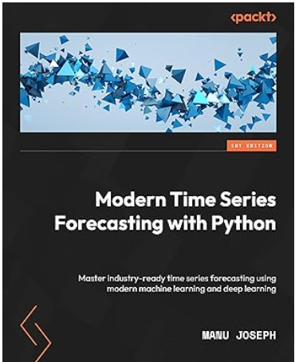

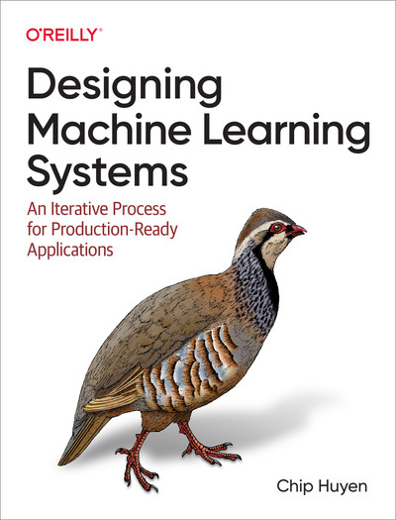
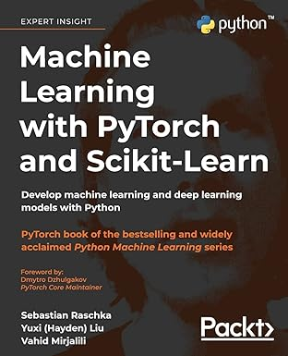
Resources for further read
https://otexts.com/fpppy/
https://openforecast.org/adam/
https://dfep.netlify.app/
Not open ☹
Bonus:
Not forecasting but always valuable->

Slide 4
Notes:
The only thing needed for this workshop is Python and some basic understanding of Machine Learning

Slide 5




How do companies make decisions?
How to ensure a region has enough electricity without over producing?
How to ensure shelves are never empty?
How to set clothing prices and promotions?
Well, just look at the data.

Slide 6
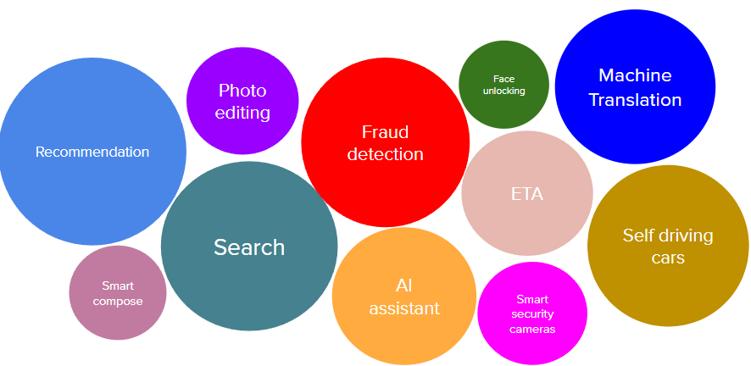
Data Driven Decision Making
The process of using analyzed and processed data to guide business decisions
More & Better Data
More & Harder Decisions

Slide 7

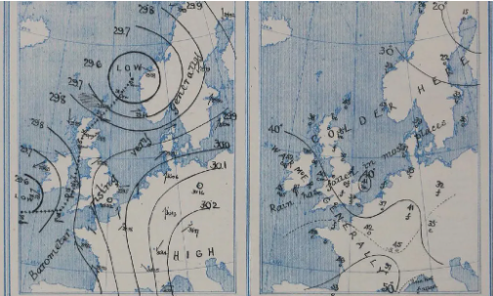
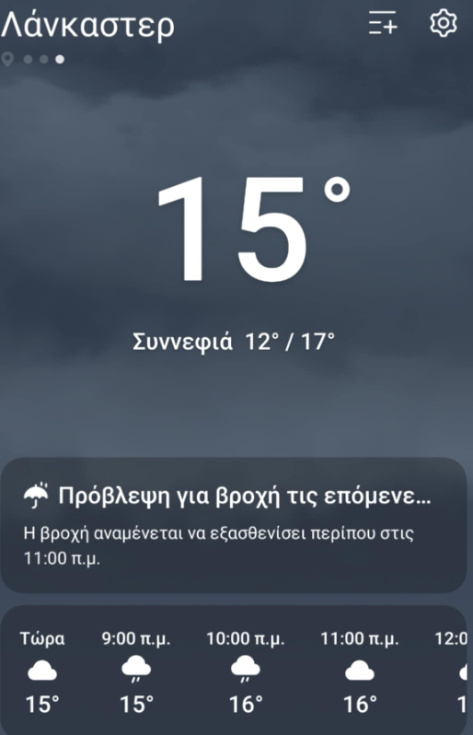
Decisions that require predictions
A specific type of decisions:
Make a predictions based on past data
Make a decision for the future
Evaluate decision based on realization of event
Notes:
Then lets look at specific types of decisions

Slide 8



Decisions Based on Predictions.
Predictive analytics (Forecasting) is the process of using historical data to predict future outcomes using data analytics, machine learning, and statistical models
We want to predict the future in order to act now.
How to obtain $z_{i, T+1}…+z_{i, T+h}$

Slide 9




An Explosion of Predictive Analytics Applications
Electricity load
Retail demand
Traffic
Econometrics
What changed?
Better (and more) data
Better (and more) questions
Better algorithms. Yes, AI.

Slide 10
Agenda:
Time series & Time Series Forecasting in a Nutshell
Forecasting Methods and Models
Machine Learning for Forecasting
(Advanced) Machine Learning for Forecasting in Practice

Slide 11
Section 1
Time Series & Time Series Forecasting in a Nutshell.

Slide 12



Lets formalize: What is forecasting?
A forecast is a scientifically justified assertion about a possible state of an object in the future.
Why we need it? To make informed decisions
Better Predictions => Better Decision
Better Predictions => (not necessarily) Better Solution

Slide 13
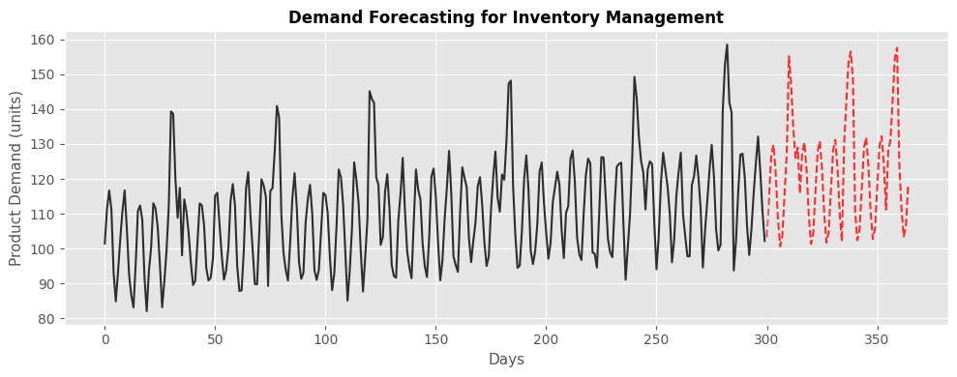
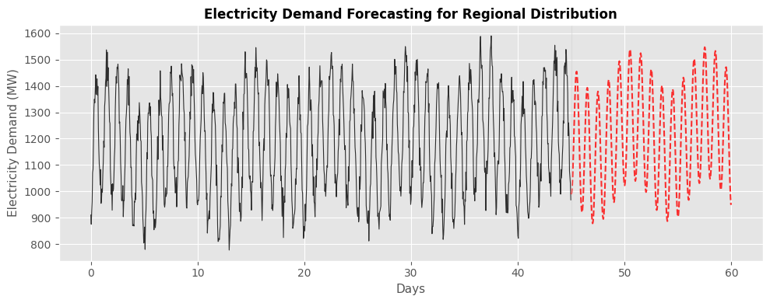
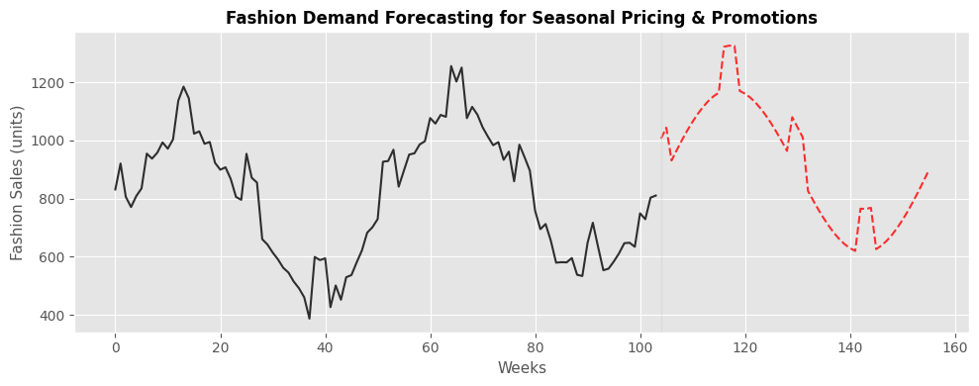
Forecasting for decision making (examples)

Slide 14
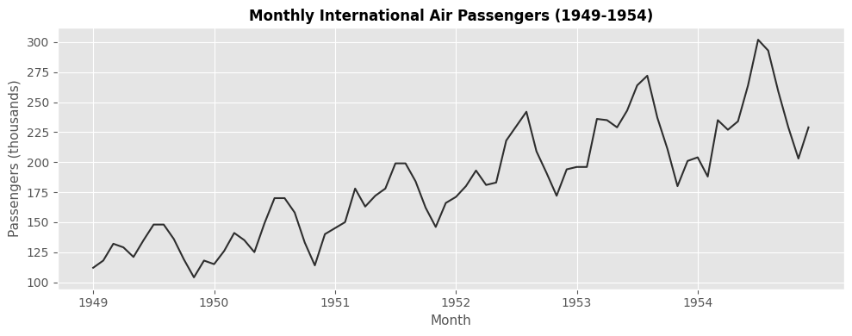
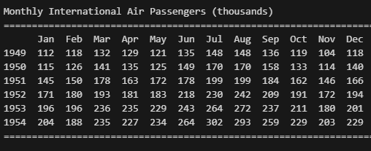
One step at the time
This is a time series
It represents events happening in chronological order over time buckets
Have fun finding patterns with this format
Why we use this format

Slide 15
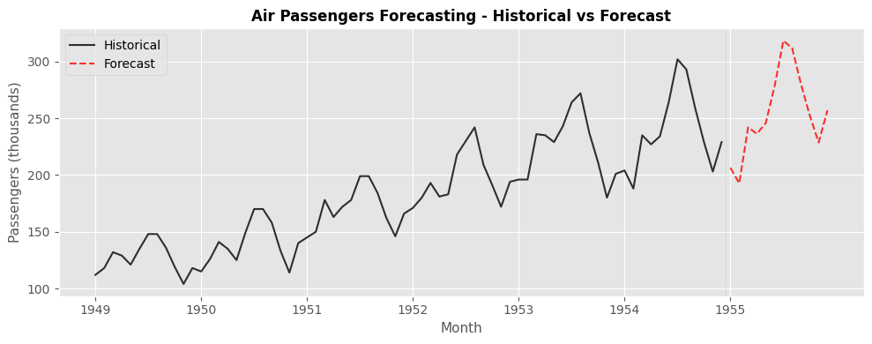
One step at the time
This is a time series
This is time series forecasting
It represents events happening in chronological order over time buckets
We are trying to:
Understand the underlying dynamics that drive these events.
Exploit them for future predictions.

Slide 16
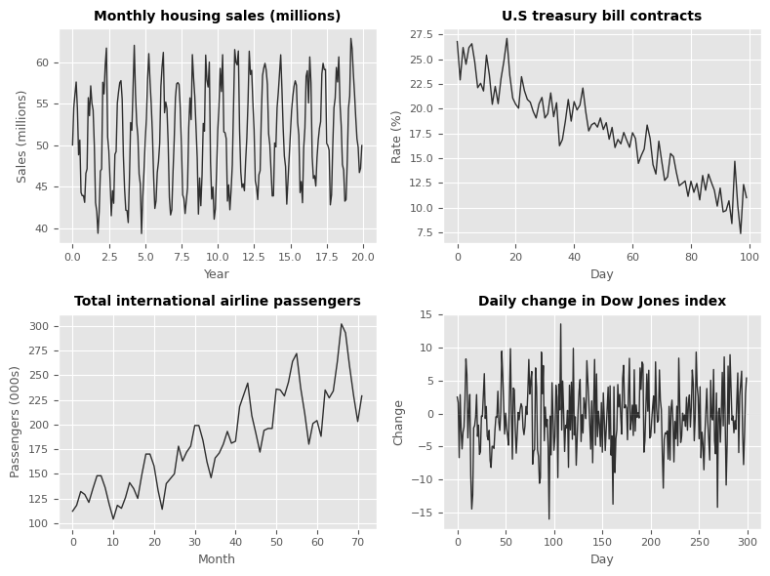
Understanding the underlying dynamics
What patterns can you see?
Which of them occur repeatedly?
What factors cause these patterns?

Slide 17
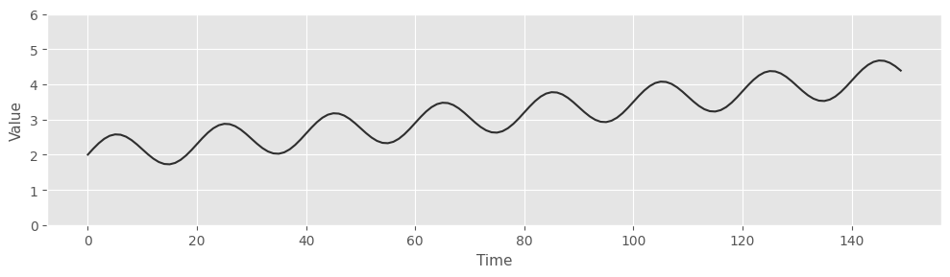
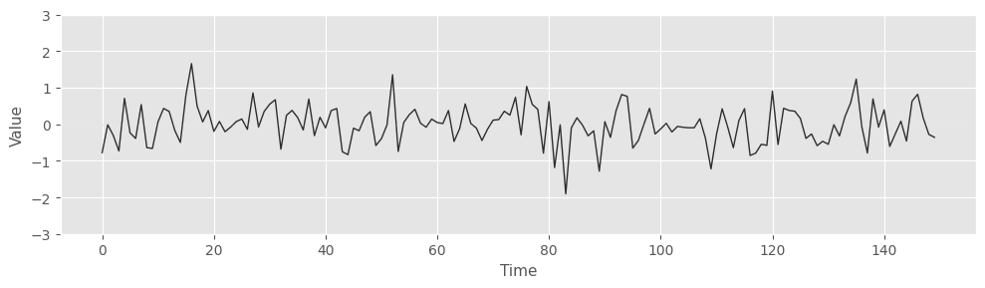
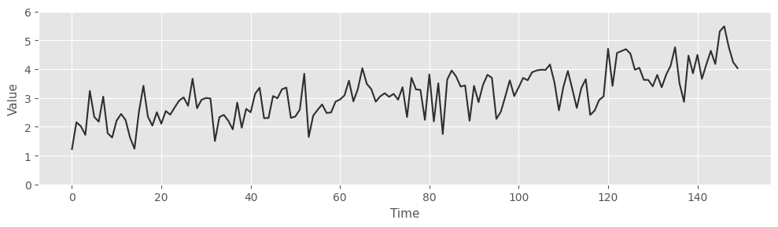
Time Series Components
Any time series contains:
Structure
Noise

Slide 18
Time Series Components
Any time series contains:
Structure
Can be captured by a model
Time series components
Explanatory variables
Noise
Fundamentally unpredictable
We can measure its size

Slide 19
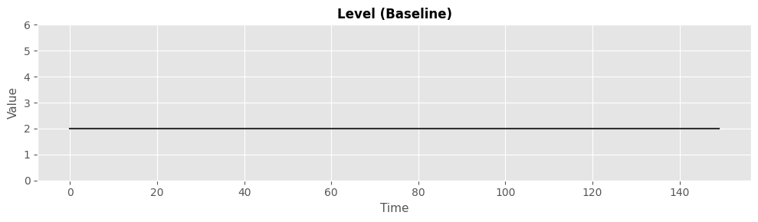
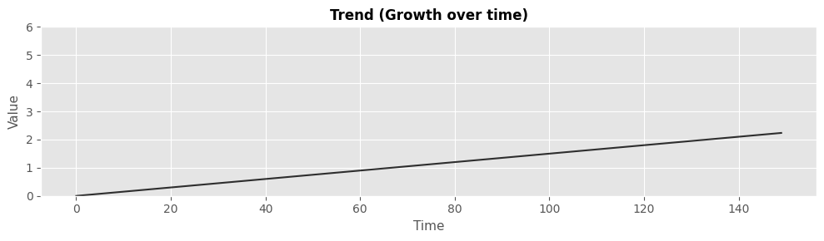
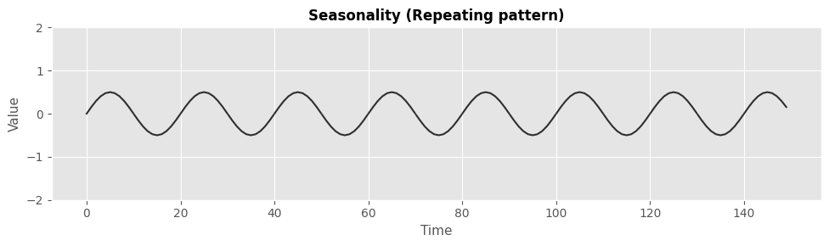
Time Series Components: Structure
Structure

Slide 20
Time Series Components: Structure
Level
The average value for a specific time period
Trend
The average increase or decrease over a time period
Seasonality
A patterns that repeats itself with a fixed periodicity

Slide 21
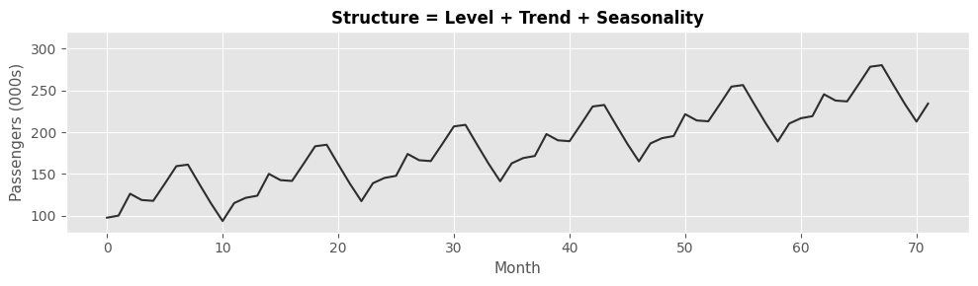
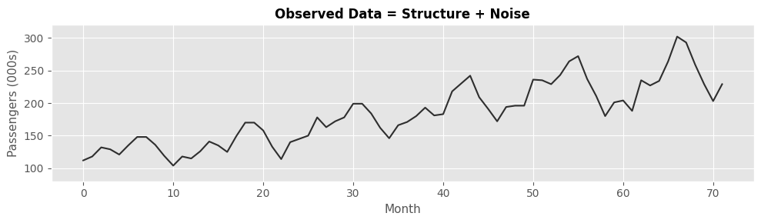
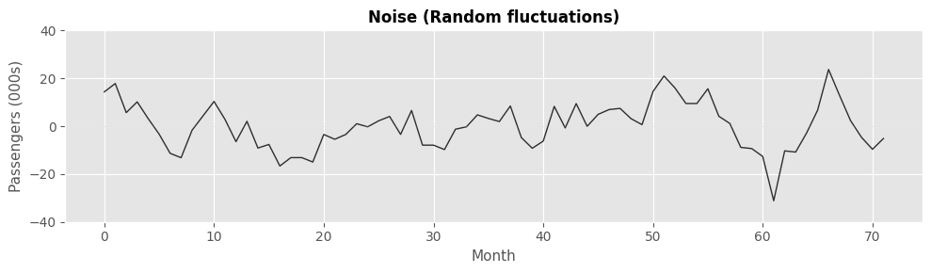
In short:
Any time series

Slide 22
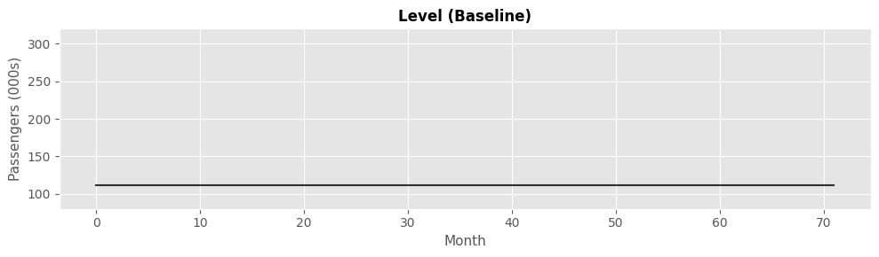
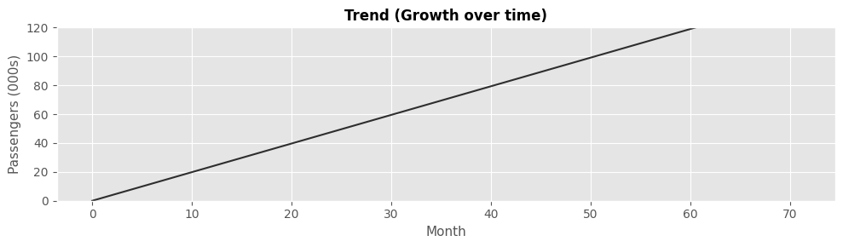
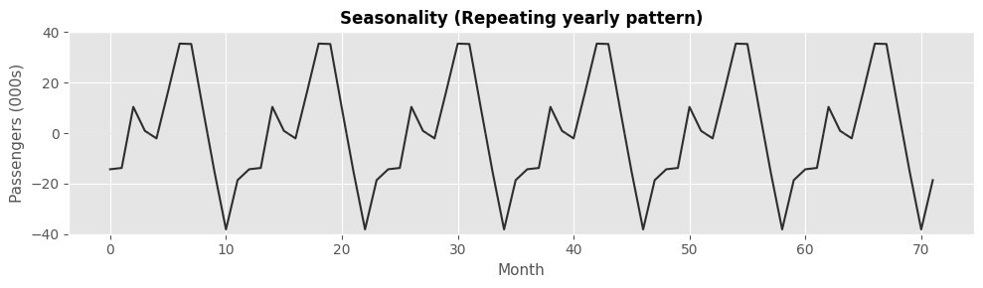
In short:
Any time series

Slide 23
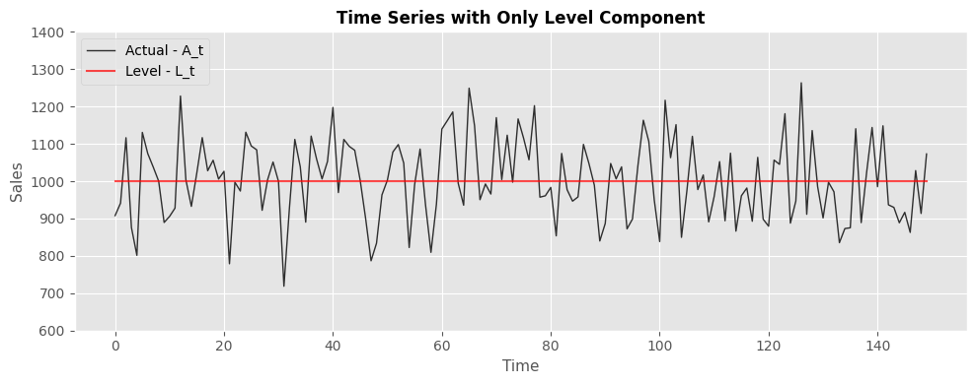
Some (of the many) additional notes
You might have no trend or seasonality

Slide 24
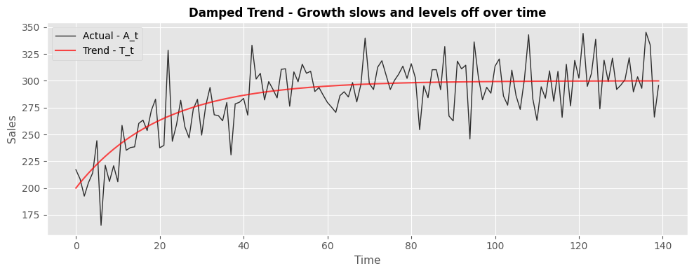
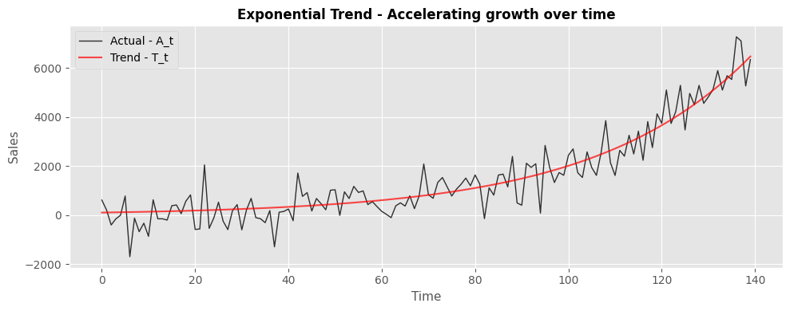
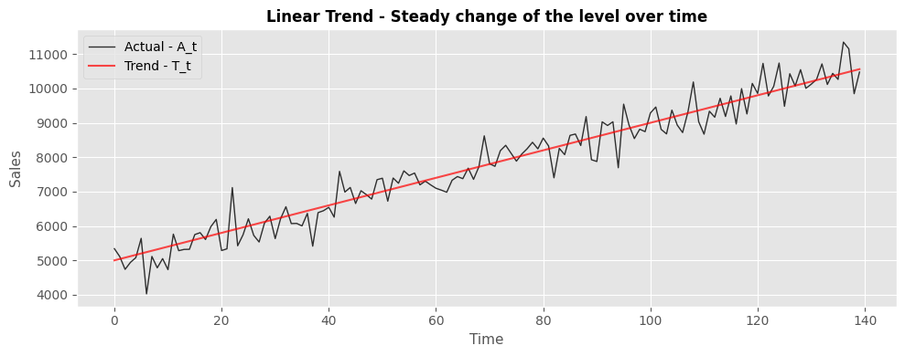
Some (of the many) additional notes
You might have no trend or seasonality
Trend comes in different flavors

Slide 25
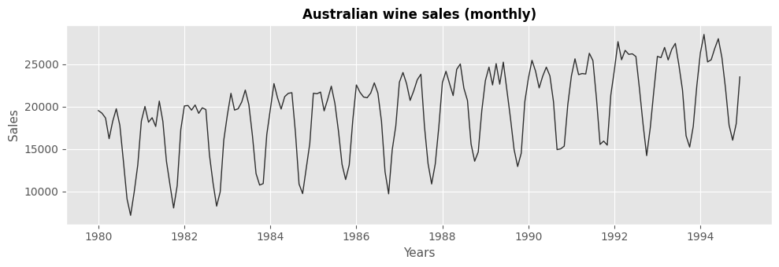
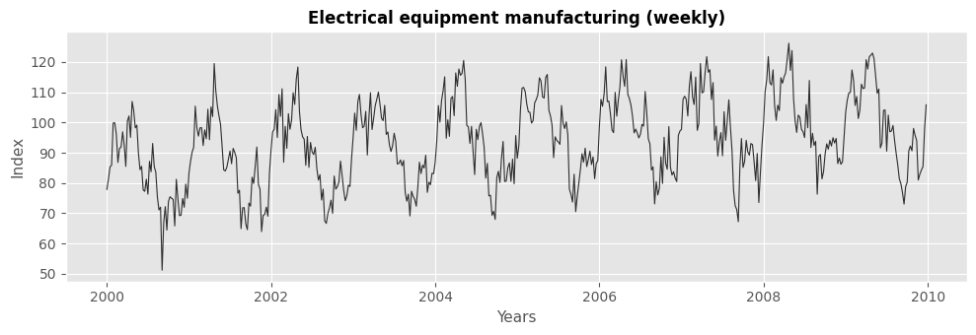
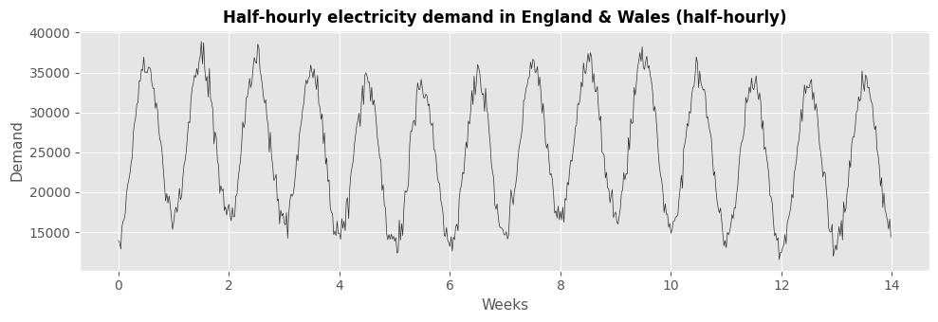
Some (of the many) additional notes
You might have no trend or seasonality
Trend comes in different flavors
We also have different seasonalities

Slide 26
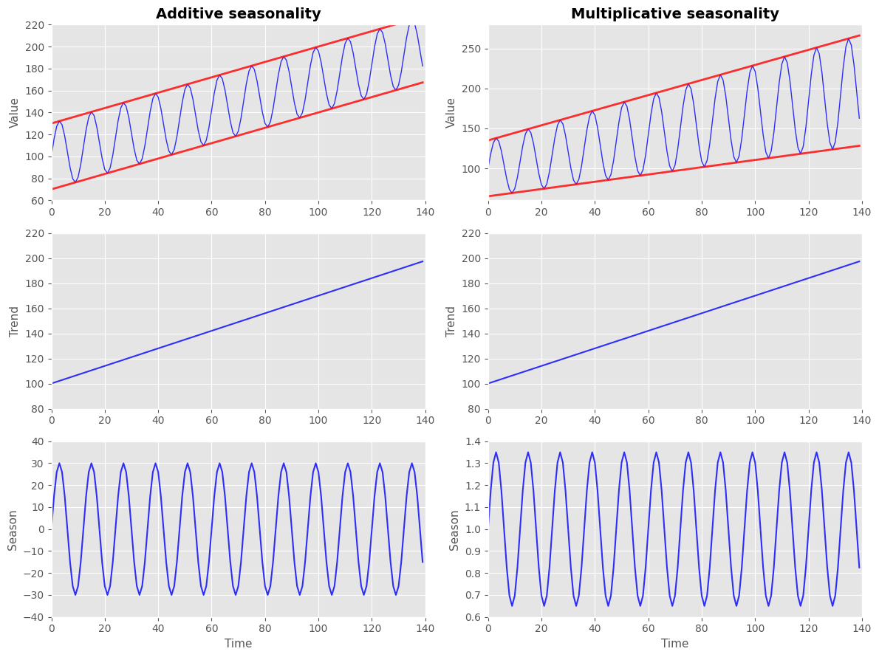
Some (of the many) additional notes
Multiplicative vs Additive
Multiplicative seasonality grows over time
Additive stays constant

Slide 27
A quick summary
A time series is a chronologically ordered sequence of events
Time series forecasting predicts the future state of an object.
To assist in decision making.
We need to understand its underlying structure, model it, and exploit it
In general, its structure is composed of structure and noise
Any time series can be broken in level, trend seasonality (& noise)
Trend and seasonality might not always be there and have various variations

Slide 28
Section 2
Forecasting: Methods and Models

Slide 29
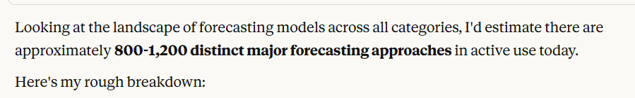
We have a zoo of forecasting models/methods
How to pick a forecaster for your application?

Slide 30
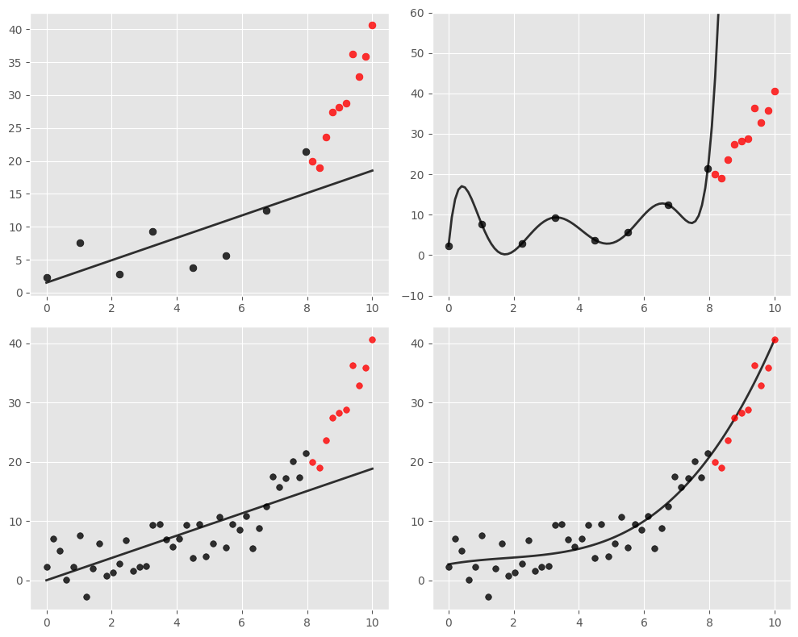

Tradeoff between balance and model complexity
low
Model complexity
high
low
Data available
Model Complexity
Fitting complex models on low data availability => overfitting
Fitting simple models on high data availability => underfitting
Data availability
high

Slide 31
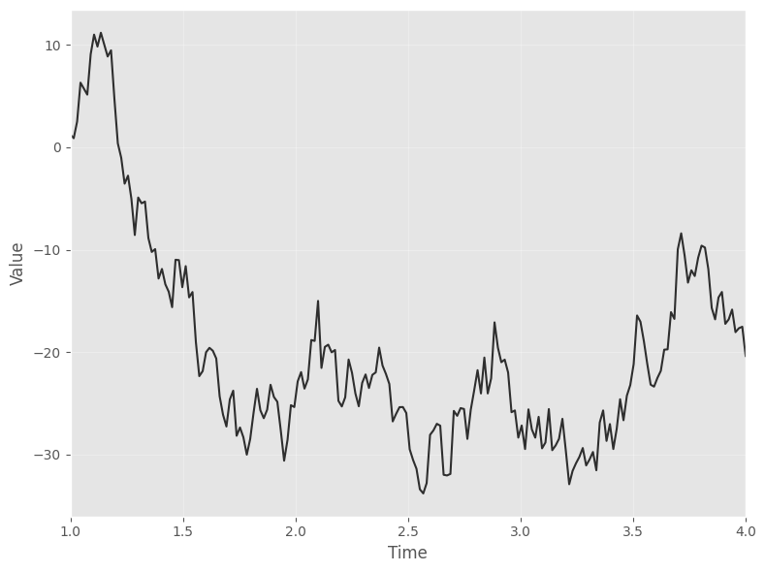
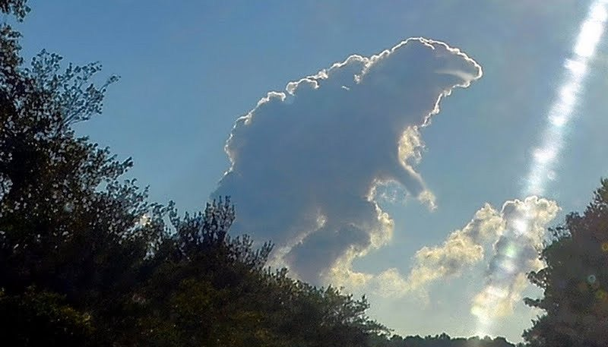
Attention: Data Availability & Structure
Remember: Time series = Structure + Noise
High data availability might mean high noise (and not high structure)
We need our models to fit on the structure and ignore noise!
How much structure does this series have?
As much as this is Godzilla

Slide 32

An attempt to classify models:
Low complexity
High complexity
Non-Parametric
Statistical Models
ML
Deep Neural Networks
The playbook:
Different models capture time series structure differently
Higher complexity models might overfit on low data availability or high noise
Higher complexity models are more fun but (much) harder to master
Plus you might not need them
Lower complexity models might be boring but do the job quickly
Takeaway: Start simple and escalate steadily until you are satisfied!

Slide 33
Section 2.1
Non-Parametric Models

Slide 34
Non – Parametric Models
Low complexity
High complexity
Non-Parametric
Statistical Models
ML
Deep Neural Networks
Extremely simple methods with no training parameters
Surprisingly good in many applications
Important to use as a benchmark before going “deeper”
Especially good in high noise situations

Slide 35
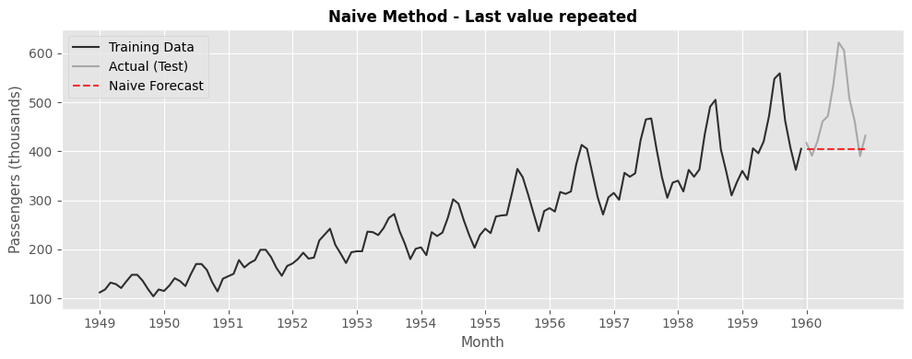
The Naïve Method
The simplest possible method.
Repeats the last known observation.
A straight line.
Good for time series without structure.
No need for more complex models if you cant best this.

Slide 36
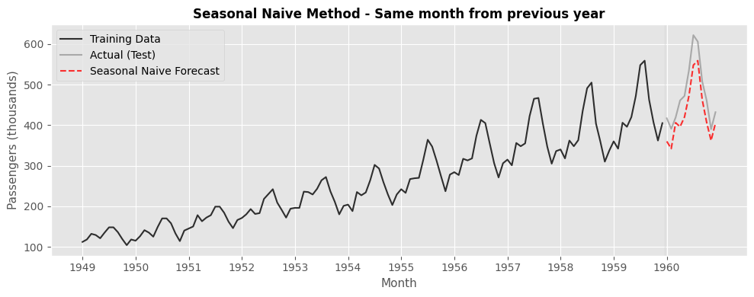
The Seasonal Naïve Method
Repeats the last known observation from the same seasonal period
Example: Predictions equals same value as last Tuesday
Very good for highly seasonal data

Slide 37
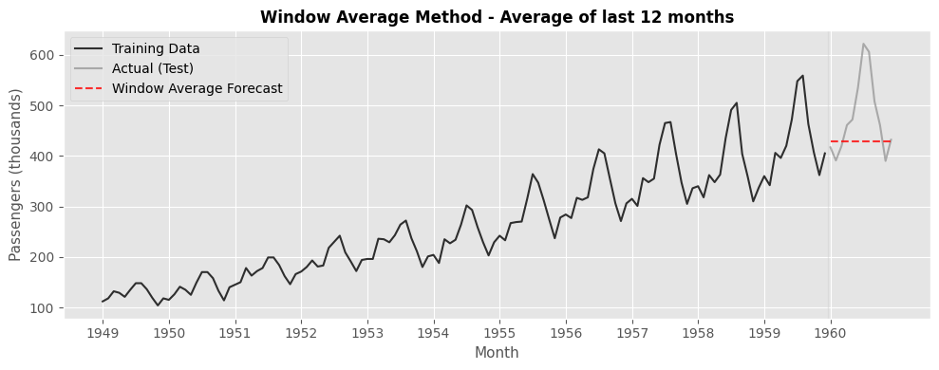
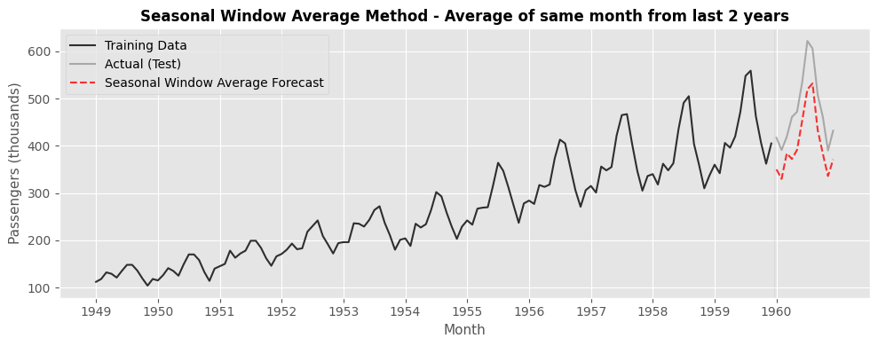
The (Seasonal) Window Average
Average of the last k observations (or seasonal observations)
Very good in estimating simple structures (level & simple seasonalities)

Slide 38
Section 2.2
Statistical Models.

Slide 39
Statistical Models
Low complexity
High complexity
Non-Parametric
Statistical Models
ML
Deep Neural Networks
Models allows us to fit a parametric function into the structure, compress it into its parameters and then use it to produce predictions
Good for low (to medium) data availability with some structure
Various modifications per structure component
Battle tested and still widely useful across multiple industries
Variants: ETS, ARIMA, Theta, GARCH, etc

Slide 40
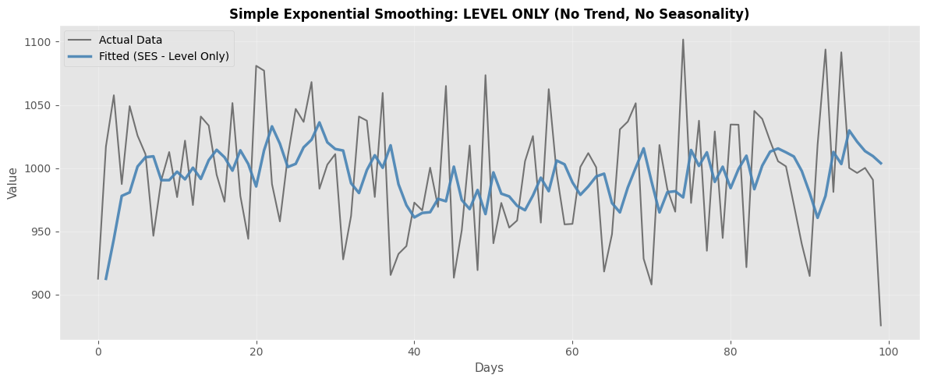
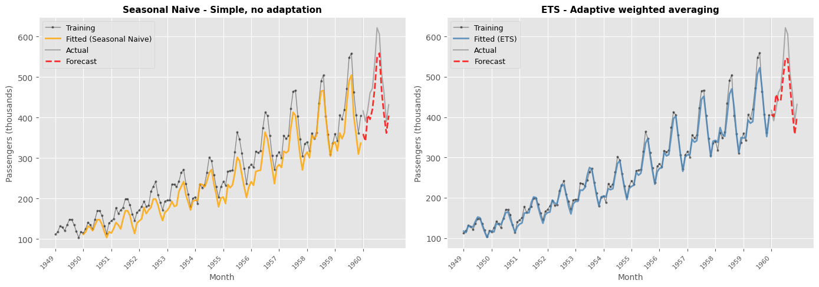
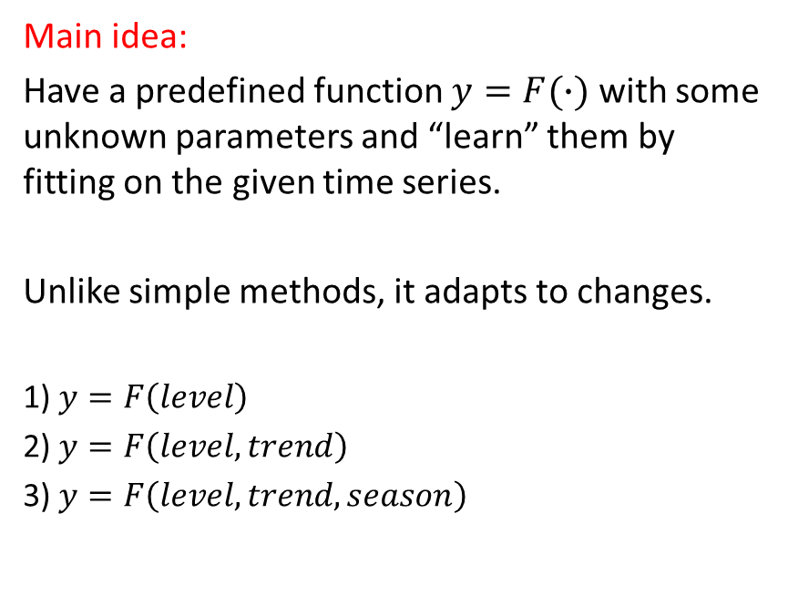
The Exponential Smoothing (ETS)
Main idea:
Have a predefined function $y=F(∙)$ with some unknown parameters and “learn” them by fitting on the given time series.
Unlike simple methods, it adapts to changes.
1) $y=F\left(level\right)$
2) $y=F\left(level,trend\right)$
3) $y=F\left(level,trend,season\right)$

Slide 41
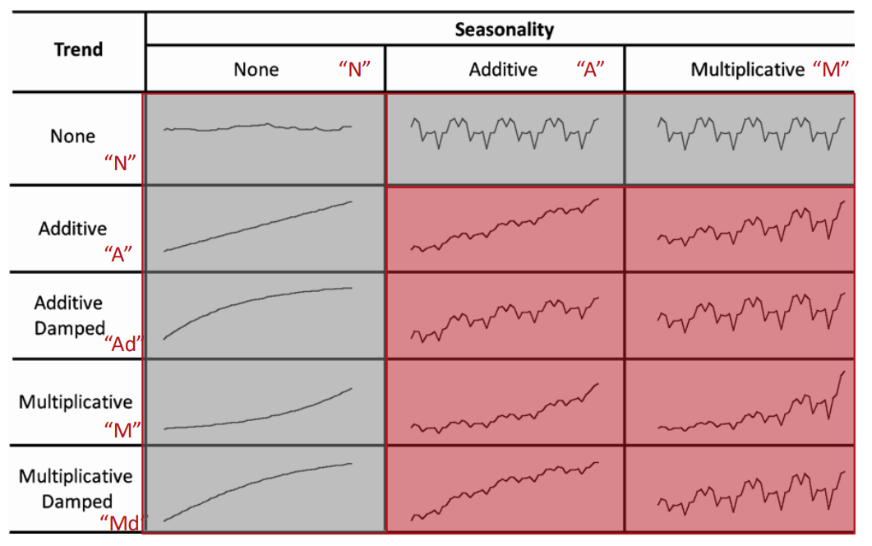
Exponential Smoothing Family of Methods
Different component combinations

Slide 42
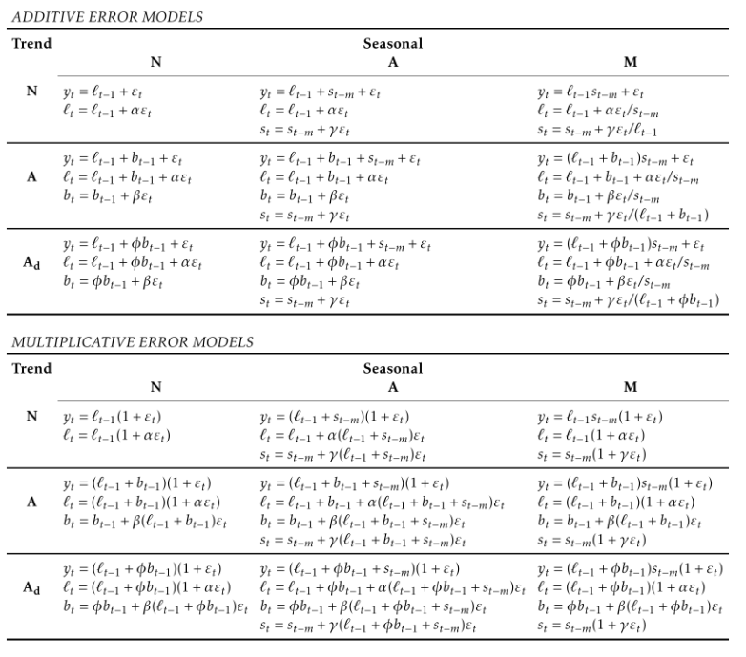
Exponential Smoothing Family of Methods
Different component combinations
Each combination has its own formula
Don’t worry, formulas are picked automatically in modern libraries

Slide 43
Summary:
Model selection is “dance” between model complexity and data availability
We are interested in modelling the structure and ignoring the noise
We have a zoo of models in 4 complexity classes
Different models capture structures differently
Non-parametric methods are very simple but work as the first baseline
Statistical models are battled tested, and have “survived” for years (for a reason)
Use more complex models if only you best these

Slide 44
Practical example 1.
Time Series, Simple Methods and Statistical Models

Slide 45
Section 3
Machine Learning for Forecasting

Slide 46
Machine Learning Models
Low complexity
High complexity
Non-Parametric
Statistical Models
ML
Deep Neural Networks
Different mindset than statistical models
More complex and flexible models
Harder to fit
Requires understanding of time series & machine learning
Requires expertise in model building
Big potential

Slide 47
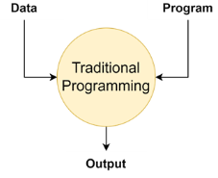



To Start With. What is Machine Learning?
“Field of study that gives computers the ability to learn without being explicitly programmed”
Arthur Samuel (1959)
“A subfield of AI that contains the application and science of algorithms that make sense of data”
“Machine Learning with Pytorch and Scikit-Learn”
Traditional Programming
DeepBlue 1997
Machine Learning
Alpha Zero 2018

Slide 48



Lets formalize this a bit.
$$F_{θ}(x)$$
Input X
Output target Y
A learnable mapping
Training Phase
Predictions Phase
Data Collection
Past Transactions
Historical Sales
New unseen data
Past Transactions
Historical Sales
$F_{θ}\left(x\right)$ =x1w1 + x2w2 + …
θ = {w1, w2, …}
Optimizing parameters θ
Model $F_{θ∗}\left(x\right)$
Parameters θ* optimized
True Labels
Fraud, Normal, Normal
12, 11, 14, 50, 11
Predicted Labels
Normal, Fraud, Normal
10, 50, 4, 55, 11
Business Decision

Slide 49



Time Series: Different mindsets - cultures
$$F_{θ}(x)$$
Past total Passengers X
Future total Passengers Y
X
Y
Algorithmic Modeling
Data Modeling
Fit parameters of a predefined function
1) $y=F\left(level\right)$
2) $y=F\left(level,trend\right)$
3) $y=F\left(level,trend,season\right)$
Learn $F_{θ}(x)$ from the data given some basic function structure

Slide 50

Step 1: Convert to supervised learning
$$F_{θ}(x)$$
Past total Passengers X
Future total Passengers Y
X
Y
We compose pairs of (X,y) where y is the future observations and X past lagged values
The longer the time series, the more pairs we have -> higher data availability -> more complex models
Number k of past lags that we use for each prediction y is a hyperparameter
Additional features & feature engineering is necessary to ensure better fit

Slide 51
Step 2: Do model selection
Linear Regression
Gradient Boosted Decision Trees
(LGBM, XGBoost, Catboost)
Neural Networks
(ANN, LSTMs, CNNs)
Special Neural Networks
(DeepAR, TFT, NBEATs, etc)
Model F
Each model brings its own priors
(more simply: its own way of capturing structures)
ATTENTION: Different models have different properties and capture structures differently.
There is a tone of academic literature comparing different models
Picking the right model is a matter of experience and expertise

Slide 52




Putting everything together:
$$F_{θ}(x)$$
Past total Passengers X
Future total Passengers Y
Step 2
Pick a Model
Step 1
Tabularize
$F_{θ}\left(x\right)= x_{1}w_{1}+x_{2}$ $w_{2}+x_{3}$ $w_{3}$+ $x_{4}$ $w_{4}$
Step 3
Make a prediction
$$\hat{y_{1}}={f(June 1949)}_{}$$
Step 4
Calculate a Loss function
Task:
Predict the total monthly Air Passengers for a full year
Step 5
Update weights using gradient descent

Slide 53
Practical example 2.
Machine Learning for Forecasting (Part 1)

Slide 54

Tradeoff between balance and model complexity
Data available
Model Complexity
The harsh reality
Fitting complex models on low data availability => overfitting
Fitting simple models on high data availability => underfitting
But simple models only capture simple patterns.
But with low data we cant leverage the full potential of ML models
The case of limited data:
Small/Medium Enterprises don’t hold a lot of historical data
But their data is full of complex patterns.
How to improve their forecasts?

Slide 55

Where to learn from?
Time series A
Local Learning: A model per time series
Most “traditional” approaches.
Time series have limited historical data
That means limited number of parameters
That means “simpler models”

Slide 56

Where to learn from?
Time series A
Local Learning: A model per time series
Most “traditional” approaches.
Time series have limited historical data
That means limited number of parameters
That means “simpler models”
Global Learning: A model for all time series
Increase the width and not the length
Allow for higher capacity models (NNs, GBDTs, etc..)
Theoretical evidence for improved performance
Time series B
Time series C
Time series D
Time series E
Time series A
Time series B
Time series C
Time series D
Time series E
Width
Length

Slide 57





Global vs Local Learning
Train a unique model
Local Learning:
Train a unique model
Train a unique model
Train a unique model
Train a unique model
Global Learning:
Train a single, more complex model

Slide 58
Practical example 2.
Machine Learning for Forecasting (Part 2)

Slide 59


Deep Neural Networks
Low complexity
High complexity
Non-Parametric
Statistical Models
ML
Deep Neural Networks
Global learning: $y=F(X)$ that learns from all time series in the dataset
“Shallow ML” like GBDTs have some structure
Neural Networks are powerfull function approximators (theoretically learn any function)
So basicaly any time series structure?
Their flexibility in the noisy low data availability area of time series can lead to poor performance without restrictions.

Slide 60

Two schools of thought
1. GBDTs: Decision Trees for Different Sets of Features:
  Different weak learners for diverse features
  Informative feature space ⬄ More holistic view for the task.
  Require a detailed description of the problem
  (eg paper size, average number of dots, total folds etc)
2. Neural Networks: Transform the Feature Space
  Multiple affine transformations
  Find a meaningful representation of the feature space
  Unfold the paper (given enough data) and count
Imaginary Problem:
Count dots inside the folded paper

Slide 61


Building neural networks for forecasting
Building Neural Networks is engineering art.
You need to understand how each brick operates
(Eg: Feed forward NNs does not understand sequences)
We restrict the function space of models through architectural selections!
LSTMs for sequence
Convolutions (or temporal convolutions) for time patterns
Transformers for long dependencies (but miss time information)
Note: Each architecture requires different fitting & preprocessing steps. Mastering is hard!

Slide 62



Try well-known architectures first
Talented researchers have already built cool models:
DeepAR -> LSTM with probabilistic output
NBEATs -> Blocks of Feed Forward NNs
TFT -> Combination of Attentions with LSTMs
-former -> many Transformer based architectures
More on this later on your course ☺

Slide 63
Practical example 2.
Machine Learning for Forecasting (Part 3)

Slide 64
Section 4
Machine Learning for Forecasting in Practice (Advanced)

Slide 65

Machine Learning is easy, right?
Collect data
Train model
Use your model for business decisions

Slide 66
Machine Learning is easy, right?
Choose a metric to optimize
Collect data
Train model
Realize many labels are wrong -> relabel data
Train model
Model performs poorly on one class -> collect more data for that class
Train model
Model performs poorly on most recent data -> collect more recent data
Train model
Deploy model
Dream about $$$
Wake up at 2am to complaints that model biases against one group -> revert to older version
Get more data, train more, do more testing
Deploy model
Pray
Model performs well but revenue decreasing
Cry
Choose a different metric
Start over
Steps 15 and 17 are essential

Slide 67

The Forecasting Lifecycle
Scoping: Clearly define the project, the goals, the objectives, etc
Data: Collect, extract or acquire the data needed
Modelling: Train your AI Model
Deployment: Put the model “in production” for decision making

Slide 68

Scoping
Before we start it is essential to consider:
What task are we trying to solve?
How can future predictions assist us?
Is it feasible?
Will my solution add value?

Slide 69

Case Study: Improving Students Exam Performance
Our goal: Assist students in exams using online activity data
Our plan: Use predictive analytics to predictive the performance of students in exams
Our data: Students online activity.

Slide 70

Case Study: Improving Students Exam Performance
Our goal: Assist students in exams using online activity data
Our plan: Use predictive analytics to predictive the performance of students in exams
Our data: Students online activity.
Exam
Period
Early Semester
Mid Semester
Late Semester

Slide 71
Case Study: Improving Students Exam Performance
Our goal: Assist students in exams using online activity data
Our plan: Use predictive analytics to predictive the performance of students in exams
Our data: Students online activity.
Without scoping:
Collect data from past years
Train a model
Wait for exams
Predict
Then?
Most common
Forecasting date

Slide 72
Case Study: Improving Students Exam Performance
Our goal: Assist students in exams using online activity data
Our plan: Use predictive analytics to predictive the performance of students in exams
Our data: Students online activity.
With scoping
How will I use my prediction?
Will the student have time to adjust?
Are predictions only sufficient?
Most common
Forecasting date

Slide 73

Case Study: Improving Students Exam Performance
Our goal: Assist students in exams using online activity data
Our plan: Use predictive analytics to predictive the performance of students in exams
Our data: Students online activity.
Data Collection
Strategy Adjustment
With scoping
How will I use my prediction?
Will the student have time to adjust?
Are predictions only sufficient?
Our Solution:
Automatic nudge those in danger
Identify what contributes to low predictions (to be discussed)

Slide 74



Can I build a feasible solution?
Assume you build software for self-driving car
Sometimes, our data is not enough

Slide 75



In Predictive Analytics:
Easy
Hard
Impossible
There is a threshold on “how much” we can predict
(Otherwise, everyone we would be billionaires)

Slide 76

Model Selection Playbook
There no such thing as “a perfect model”
Different models are for different tasks.
We usually pick the model that reduces the error metric we picked
On the test set!!
Train set
Test set
Step 1: Split and keep a period as a “test set”.
Step 2: “Train” a model on the “train” set.
Step 3: Make predictions for the “test” set.
Step 4: Compare predictions with the true values
Step 5: Pick the model with the lowest error
$$Error=Forecast−Demand$$

Slide 77

Model Selection Playbook
There no such thing as “a perfect model”
Different models are for different tasks.
We usually pick the model that reduces the error metric we picked
On the test set!!
Step 1: Split and keep a period as a “test set”.
Step 2: “Train” a model on the “train” set.
Step 3: Make predictions for the “test” set.
Step 4: Compare predictions with the true values
Step 5: Pick the model with the lowest error
Advanced: Repeat on multiple horizons!
$$Error=Forecast−Demand$$

Slide 78


Picking an Error Metric
Different forecasting metrics have different properties
Bad metric selection leads to bad decisions
Best practice: Use multiple metrics!
Metric 1
Advanced tip:
Consider scale-independent metrics
Metric 2
Metric 3

Slide 79


Slide 80




Golden Rule: Better Data Over Better Model.
“Dog”
“Dog”
AI Model
“Dog”

Slide 81


Case Study: Sales Predictions
We have asked Demand Planners how easy was to predict future sales given this

Slide 82





Case Study: Sales Predictions
We have asked again after breaking the signal down
Weekly Seasonality
Trend
Holidays
Discounts
Repeated patterns every week
General upwards trend
Drop due to holidays
Spikes due to discounts

Slide 83




Case Study: Reduce Food Waste
Historical Sales
Orders Placed
Stock Levels
Costumer Details
AI Model
Decision
Internal Decisions
Promotions
Product Description
Other predictors

Slide 84


Slide 85
A Complex Tradeoff
⬇️Simple models – low parameters
✅No big data requirements
❗️Can only identify simpler patterns
📝Simple methods and statistical models
⬆️Complex models – more parameters
✅Can extract more complex patterns
❗️But requires more (and informative data)
📝ML (Neural Networks)
Model selection depends on the task at hand

Slide 86
Navigating the Zoo
Low complexity
High complexity
Non-Parametric
Statistical Models
ML
Deep Neural Networks
Efficiently Globally Scalable
The playbook: Use the simplest model possible!!
Good scoping for metric selection and target added value
Start very simple (non-parametric methods)
Progress only if there is potential for improvement
Watch for diminishing returns -> a complex model might overfit!
If you are stacked with ML models, scope again (more/better data, feasibility)

Slide 87

Deployment!
Deployment is the process of integrating a trained machine learning model into a production environment to make it available for end-users.
Out of current scope. Happy to discuss ☺

Slide 88
Summary:
Applying machine learning in practice is not straightforward
You first need to understand what you are forecasting and why
Designing a good evaluation framework is extremely important
Gather as much data as possible that can predict the structure
During model selection, start simple improve step by step

Slide 89
Practical example 3.
An end-to-end forecasting application.

Slide 90





Thank you for your attention
Questions?
filotas.theodosiou@vives.be
https://github.com/FilTheo
https://www.linkedin.com/in/filotas-theodosiou/
https://filtheo.github.io/
©mrsiraphol

